Slide 1


SUMMARY LESSON
1.Turning effect of force
1
1. Lever
2. Inclined Plane
3. Gear and Belt System
4. Pulley Wheel and Axle
2
1. Electrical Energy
2. Household Wiring System
3

Slide 2
SUMMARY LESSON
1.The magnetic field
2. Magnetic Force
4
1. Light
2. Reflection
3. Mirror
4. Refraction
5. Lenses
5
Prepared By:
Instructor: MOEUN Sokmean

Slide 3



Contents
1
Turning effect of a force
2
Simple Machines
3
Electricity
4
Magnetic Field
5
Light
6
Summary

Slide 4
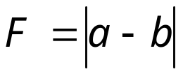




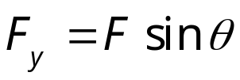









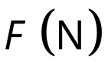
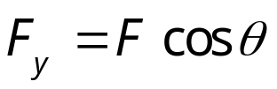


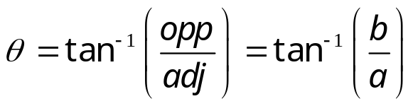
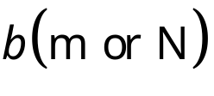
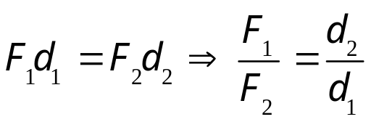

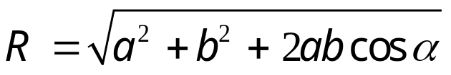
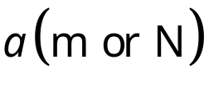

Chapter1: Turning effect of force
Turning effect of force
Resultant Force
❍ Opposite direction
Resolving Force
Moment
❍ Horizontal Force
❍ Vertical Force
Net moment
Moment of a force
❍ Same direction
❍ Horizontal Force
❍ Vertical Force
Moment of a force:
Force:
❍ At 90° angle
Perpendicular distance:
❍ Direction of a resultant force
Two parallel forces
Principle of moment: M_{ACW} = M_{CW}
❍ At angle α
Force F_{A}:
Opposite side:
Adjacent side:
Force F_{B}:
Western International School Start Your Future Today!

Slide 5
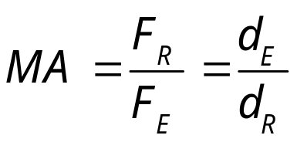
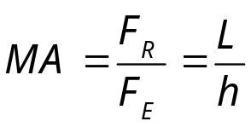

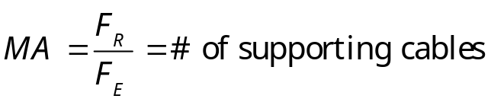
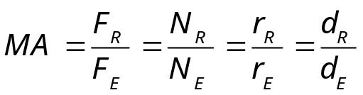


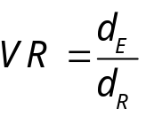

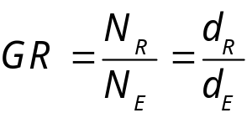
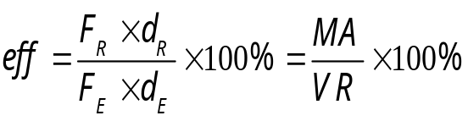



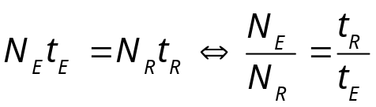
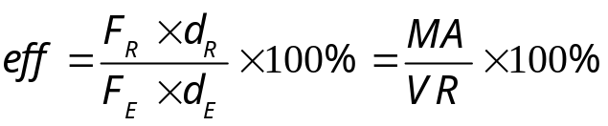

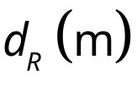
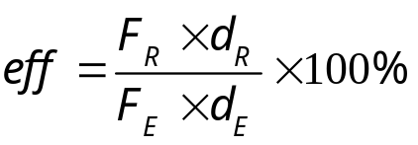
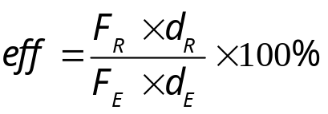
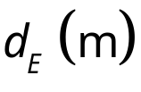
Chapter2 Simple Machines
Simple Machine
Lever
Inclined Plane
Pulley
Gears System
❍ Mechanical advantage
❍ Mechanical advantage
❍ Mechanical advantage
❍ Mechanical advantage
Ramp:
Height:
❍ Work done by load and effort
❍ Velocity Ratio
❍ Gear Ratio (GR):
❍ Effciency: eff
Pulling distance:
Lifting distance:
❍ If no friction:
❍ Relation of turns-teeth
❍ Efficiency:
Load:
Efford:
Load arm length:
❍ Efficiency:
❍ Efficiency:
Efford arm length:
Western International School Start Your Future Today!

Slide 6
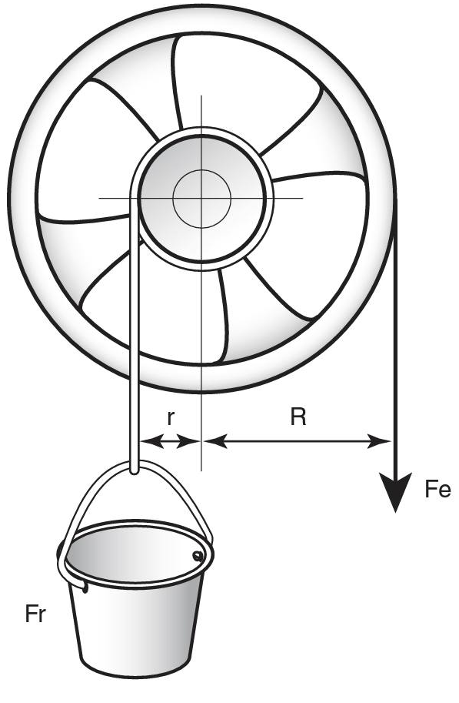
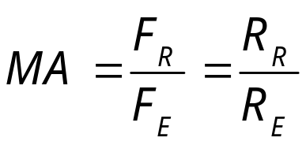

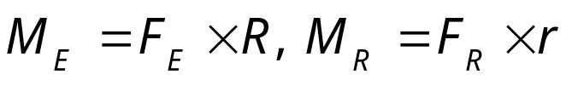

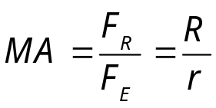


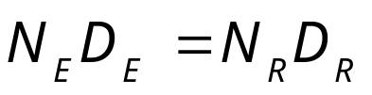


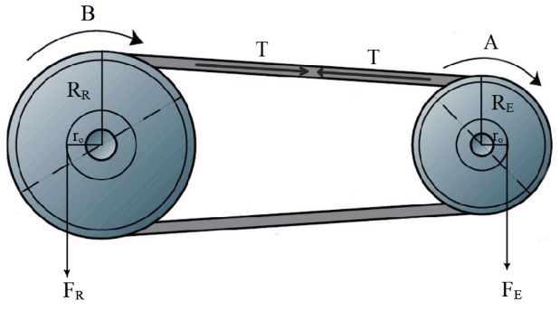


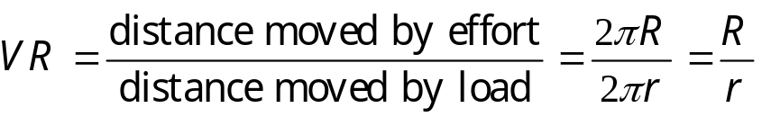

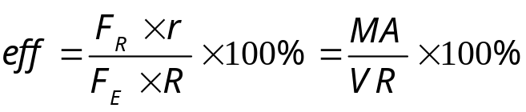

Chapter2 Simple Machines
Simple Machine
Belt System
Wheel and Axle
❍ Mechanical advantage
❍ Moment of effort and load
Radius of driver wheel :
Radius of driven wheel:
❍ Mechanical advantage
❍ Turns and diameter relation
Radius of a wheel:
Radius of an axle:
Velocity ratio:
❍ Velocity Ratio:
Efficiency:
Turns of driver wheel:
Turns of driven wheel:
Diameter of driver wheel:
❍ Efficiency:
Diameter of driven wheel:
Western International School Start Your Future Today!

Slide 7
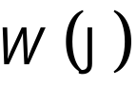
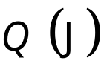
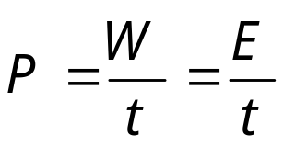
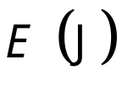
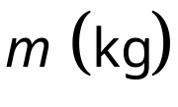
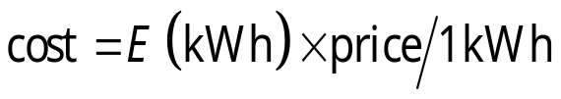
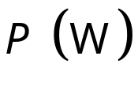
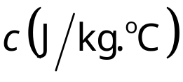
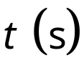
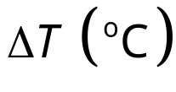
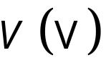

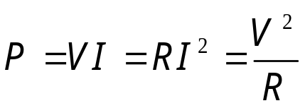
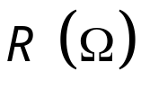
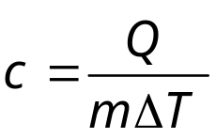
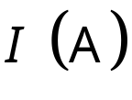
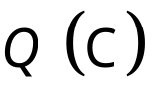
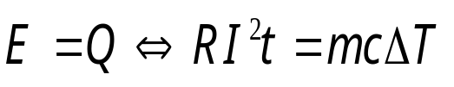

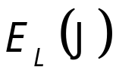
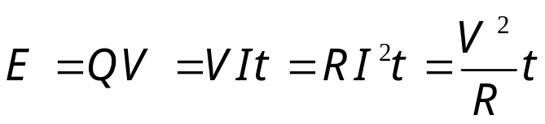

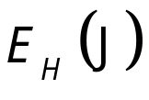
Chapter3 Electricity
Electricity
Electrical Power
Heat Energy
❍ Definition of power
Work done:
❍ Cost of using electricity
Heat energy:
Energy transfer:
Mass of a substance:
Electrical power:
Specific heat capacity:
Time taken:
❍ Heat gained or lost
Temperature change:
❍ Power of current
Voltage:
❍ Specific heat capacity
Resistance:
❍ Conservation of energy:
Electric current:
❍ Energy Transfer
Electric charge:
Light Energy:
❍ Total Energy:
Heat Energy:
Western International School Start Your Future Today!

Slide 8


























Chapter4 Magnetic Field
Magnetism
Magnetic Force
Transformers
Magnetic Field
❍ Due to a straight wire
❍ On a current carrying wire
❍ Voltage, Turn and
Current Ratio
Permeability of free
space:
Electric current:
❍ Direction of magnetic force
❍ Direction
❍ Power loss:
Distance from a wire:
Number of turns:
Length of a solenoid:
Secondary current:
Magnetic field lines
Primary current:
Secondary voltage:
❍ Due to a solenoid
Magnetic force:
Primary voltage:
Magnetic field:
Secondary turns:
❍ Direction
Length of a wire:
Primary turns:
Western International School Start Your Future Today!

Slide 9

























Chapter5 Light
Reflection of light
Light
Refraction of light
❍ The Law of Reflection
states that:
❍ Relationship between real
depth and apparent depth
❍ Snell’s Law
Angle of incidence:
❍ Critical Angle
Angle of reflection:
❍ Pinhole Camera
❍ Refractive index
Real depth:
Critical angle:
Image’s height:
❍ Shadows
Apparent depth:
First index:
Object’s height:
Speed of light in air:
Second index:
Umbra
Penumbra
Image’s distance:
Speed of light in a medium:
Incidence angle:
Central dark region
Partial shadow
Object’s distance:
Refractive index:
Refractive angle:
Western International School Start Your Future Today!

Slide 10















Chapter5 Light
Mirrors
Plane Mirrors
Curve Mirrors
❍ The Law of Reflection states that:
Angle of incidence:
❍ Mirror’s Equation
❍ Radius & focal length relation
Angle of reflection:
❍ Characteristic of the image
❍ Magnification of mirror
❍ Object’s distance
Concave mirror:
Convex mirror:
Focal length:
❍ Image’s distance
Image’s height:
Image’s distance:
Object’s height:
Object’s distance:
Radius of curvature:
Western International School Start Your Future Today!

Slide 11













Chapter5 Light
Lenses
❍ Lenses' Equation
❍ Radius & focal length relation
❍ Convex lens
Convex lenses:
Concave lenses:
❍ Object’s distance
❍ Magnification of mirror
Focal length:
Image’s height:
❍ Concave lens
Object’s height:
Image is upright:
❍ Image’s distance
Radius of curvature:
Image’s distance:
Image is in verted:
Object’s distance:
Magnification:
Western International School Start Your Future Today!

Slide 12


